Slide 1

Building a Research Program for Scripting Languages
Arjun Guha Ben Lerner Joe Gibbs Politz Justin Pombrio Junsong Li Hannah Quay-de la Vallee John Wrenn and several others! … and Shriram Krishnamurthi

Slide 2
> [] + []
// empty string
> [] + {}
[object Object]
> {} + []
0
> {} + {}
NaN
https://www.destroyallsoftware.com/talks/wat/
Gary Bernhardt

Slide 3
function bar(x) {
return function() {
var x = x;
return x;
};
}
var f = bar(200);
f()
→ 200
function bar(x) {
return function() {
var x = x;
return x;
};
}
var f = bar(200);
f()
→ undefined

Slide 4
[][(![]+[])[!+[]+!+[]+!+[]]+(!![]+[][(![]+[])[+[]]+(![]+[]+[][[]])[+!+[]+[+[]]]+(![]+[])[!+[]+!+[]]+(!![]+[])[+[]]+(!![]+[])[!+[]+!+[]+!+[]]+(!![]+[])[+!+[]]])[+!+[]+[+[]]]+(!![]+[])[+!+[]]+(!![]+[])[+[]]][([][(![]+[])[+[]]+(![]+[]+[][[]])[+!+[]+[+[]]]+(![]+[])[!+[]+!+[]]+(!![]+[])[+[]]+(!![]+[])[!+[]+!+[]+!+[]]+(!![]+[])[+!+[]]]+[])[!+[]+!+[]+!+[]]+(![]+[])[+!+[]]+(![]+[])[!+[]+!+[]]+(![]+[])[!+[]+!+[]]]()[(![]+[])[!+[]+!+[]]+(!![]+[][(![]+[])[+[]]+(![]+[]+[][[]])[+!+[]+[+[]]]+(![]+[])[!+[]+!+[]]+(!![]+[])[+[]]+(!![]+[])[!+[]+!+[]+!+[]]+(!![]+[])[+!+[]]])[+!+[]+[+[]]]+([][(![]+[])[+[]]+(![]+[]+[][[]])[+!+[]+[+[]]]+(![]+[])[!+[]+!+[]]+(!![]+[])[+[]]+(!![]+[])[!+[]+!+[]+!+[]]+(!![]+[])[+!+[]]]+[])[!+[]+!+[]+!+[]]+(![]+[])[+!+[]]+(!![]+[])[+[]]+(![]+[]+[][[]])[+!+[]+[+[]]]+(!![]+[][(![]+[])[+[]]+(![]+[]+[][[]])[+!+[]+[+[]]]+(![]+[])[!+[]+!+[]]+(!![]+[])[+[]]+(!![]+[])[!+[]+!+[]+!+[]]+(!![]+[])[+!+[]]])[+!+[]+[+[]]]+([][[]]+[])[+!+[]]]
a.k.a., window.location
http://discogscounter.getfreehosting.co.uk/js-noalnum_com.php
“Converts javascript command [to use] only []()+! characters”

Slide 5



Let’s not let Python feel left out
def f(x):
class C(object):
x = "C's x"
def meth(self):
return x + ', ' + C.x
return C
f('input x')().meth()

Slide 6
Goal of Our Research Program

Slide 7
Program Reasoning
Static reasoning
Type-based reasoning
Security reasoning
Information for optimization
Information for programming environments
…
Sound reasoning
Because lying is both bad and dangerous

Slide 8


Slide 9
to soundly enforce the policies mentioned above, […] needs to statically reason about the program heap. To this end, this paper proposes the first points-to analysis for JavaScript
In our staging framework, the heavyweight flow analysis is carried out just once on the server and its results are distilled into succinct residual checks, that enjoy two properties. First, they soundly describe the properties that are left to be checked on the remaining code once it becomes known
We present a static program analysis infrastructure that can infer detailed and sound type information for JavaScript programs using abstract interpretation.

Slide 10
Soundness requires proof
Proof requires truth
Truth is given in a semantics
But first…

Slide 11
what is a scripting language?

Slide 12
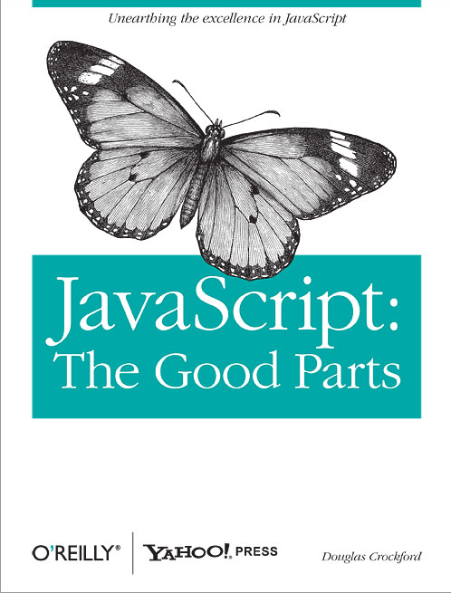
"JavaScript has much in common with Scheme […] Because of this deep similarity …"
(
)

Slide 13
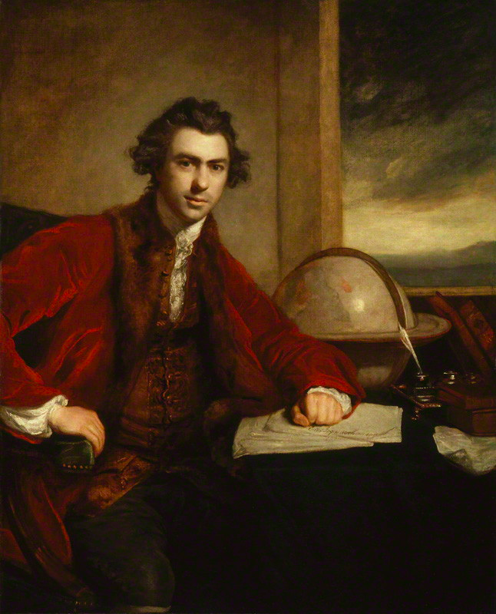

This is a scripting language!
http://www.thelanddownunder.com.au/content/product/full/Platypus_IndoorOutdoor_Statue-164-4.jpg
https://upload.wikimedia.org/wikipedia/commons/6/6e/Joseph_Banks_1773_Reynolds.jpg

Slide 14
"JavaScript has much in common with Scheme […] Because of this deep similarity …"
(
)
No help to researchers studying Web security, building JavaScript analyses, etc.

Slide 15
Technical Issues
Concept
Example
objects = dictionaries
in-language reflection
odd scoping rules
overloading
too many behaviors
value redefinition
antisyntactic definition
eval
o.x = o[“x”]
if (hasField(o, “x”))
x = x
+
{} + []
XMLHttpRequest = …
if = …
eval
All these “features” are antithetical to static reasoning

Slide 16
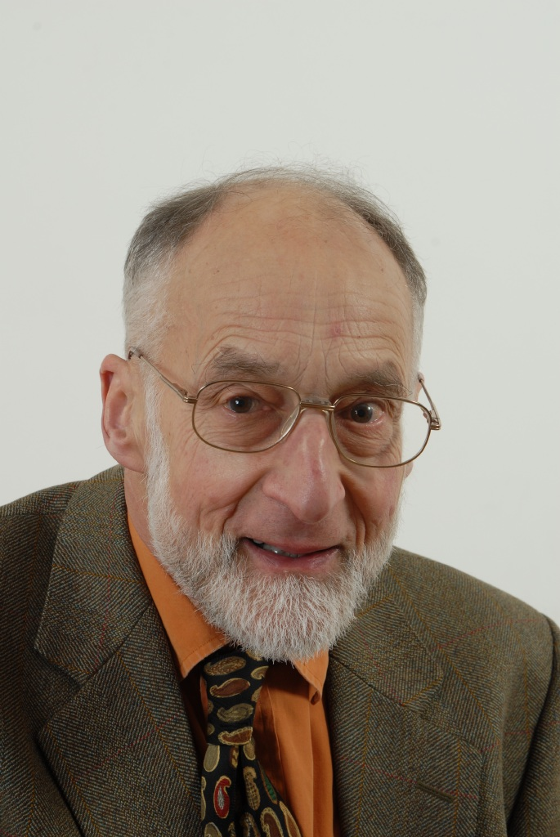
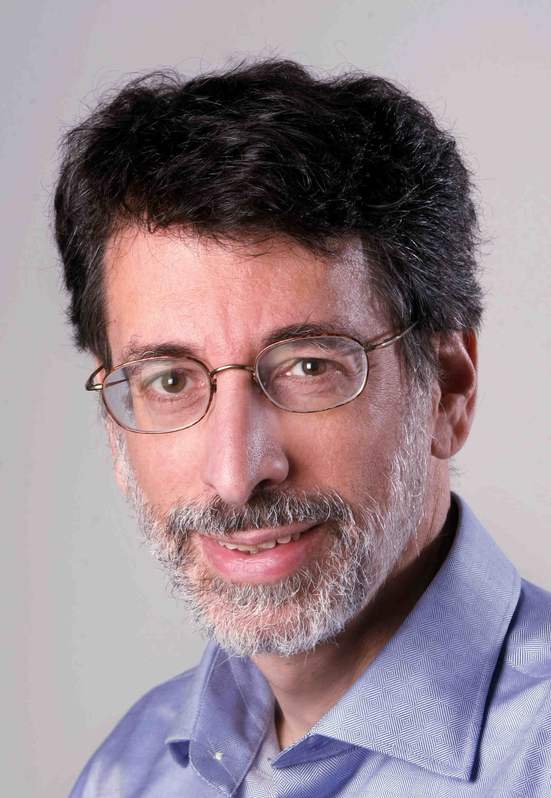
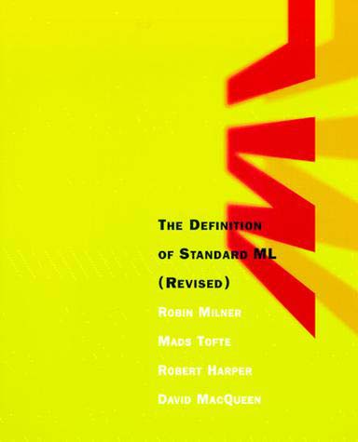
https://mitpress.mit.edu/sites/default/files/9780262631815.jpg
http://www.cl.cam.ac.uk/archive/rm135/10.jpg
https://www.cs.princeton.edu/~appel/appel.jpg

Slide 17

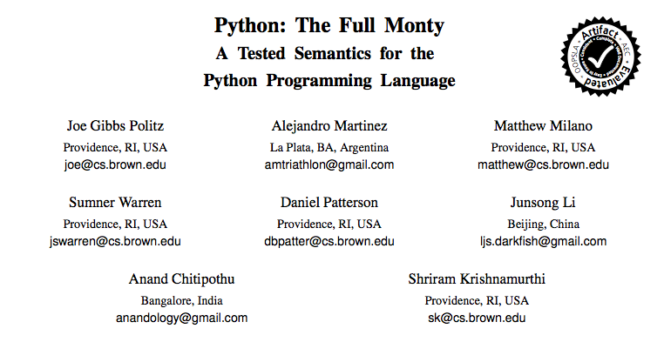

Slide 18
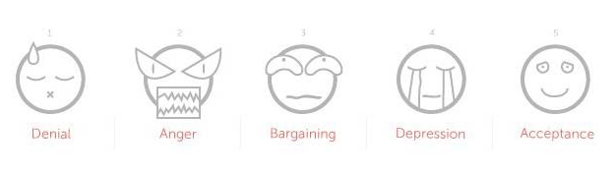
Scripting languages are like objects found in nature
The correct “science” is natural science, experimental in flavor
https://media.licdn.com/mpr/mpr/p/7/005/0ae/142/1c3962e.jpg

Slide 19
Semantics
Type Systems
Security and Other Uses
Issues with Desugaring
Future Directions

Slide 20
Semantics for a Scripting Language

Slide 21
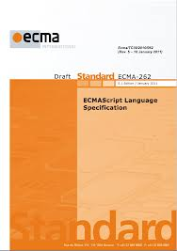
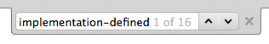
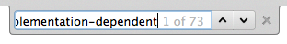
What About the Spec?
Spec is embodied in implementations
Spec is incomplete: e.g., SES depends on window.console
Spec depends on implementations
Attackers attack implementations, not specs

Slide 22
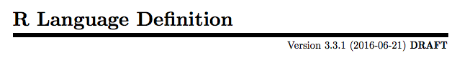
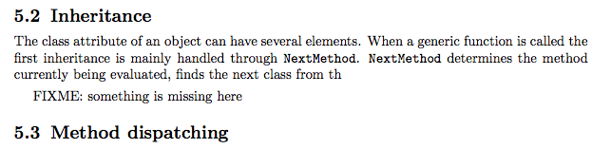
https://cran.r-project.org/doc/manuals/r-release/R-lang.pdf#page=33

Slide 23
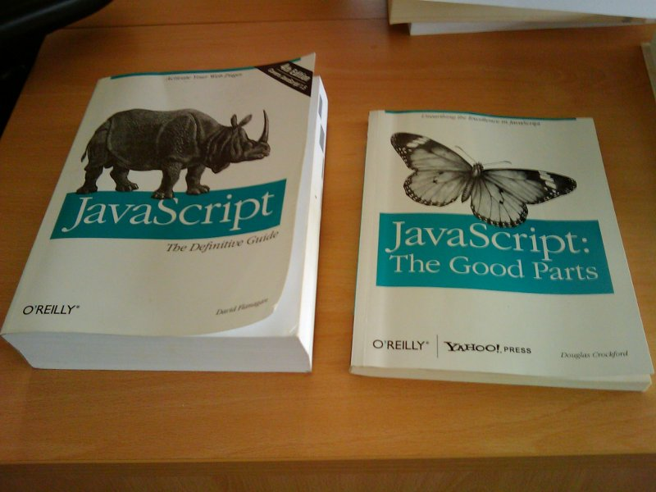
Thanks, Emery Berger

Slide 24
Two Key Properties
Correctness (Is it right?)
Completeness (Does it cover the whole language?)

Slide 25
JavaScript program
A tested semantics
SpiderMonkey, V8, Rhino
Semantics
“their answer”
“our answer”
identical for some large test suite

Slide 27
Control Operators
if, ?:
while, for, do, for in
switch, continue, break, label:
&&, ||, throw, try catch finally

Slide 28
Three Two Key Properties
Correctness (Is it right?)
Completeness (Does it cover the whole language?)
Is it … useful?

Slide 29
Four Three Two Key Properties
Correctness (Is it right?)
Completeness (Does it cover the whole language?)
Is it … useful?
Is it … insightful?

Slide 30
JavaScript program
desugar
λ_{JS} program
SpiderMonkey, V8, Rhino
100 LOC interpreter
“their answer”
“our answer”
identical for some large test suite

Slide 31
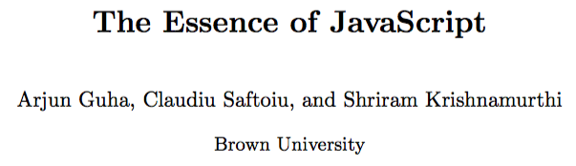
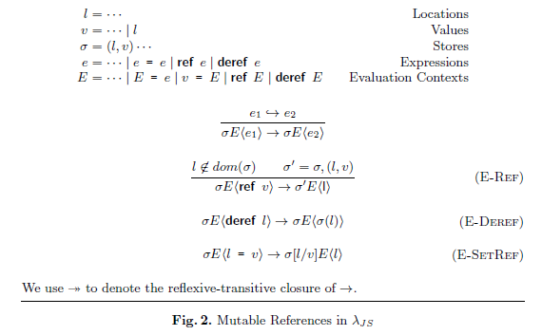
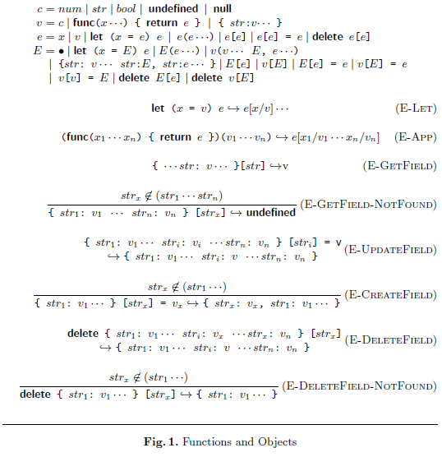
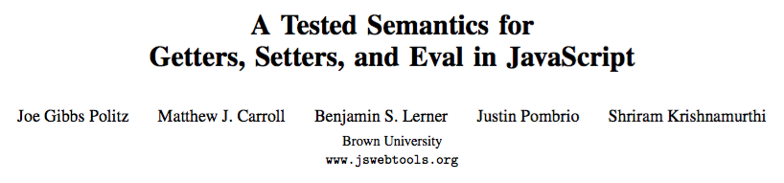
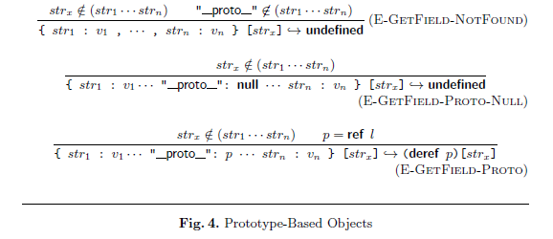

Slide 32
L program
desugar
λ_{L} program
Curated “essence”—provides insight
Target for proofs
Target for tools
What we as scientists should do
L evaluator
λ_{L} evaluator
“their answer”
“our answer”

Slide 33
Semantics
Type Systems
Security and Other Uses
Issues with Desugaring
Future Directions

Slide 34
Types for Scripting Languages

Slide 35
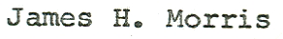
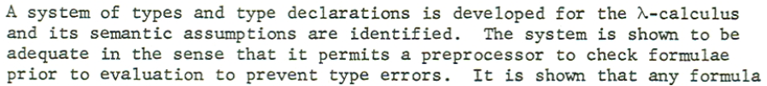
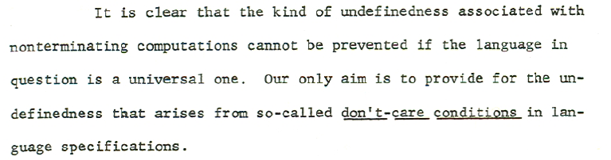
PhD 1968

Slide 36
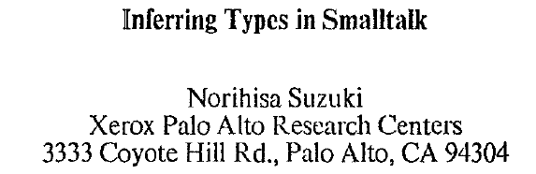
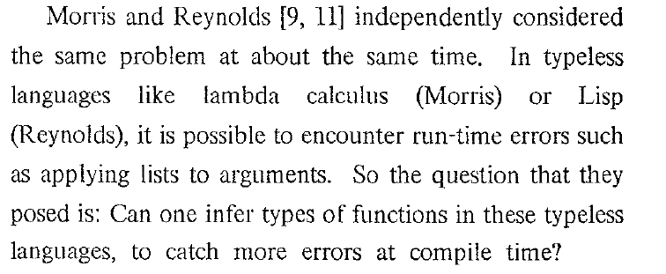
POPL 1981

Slide 37
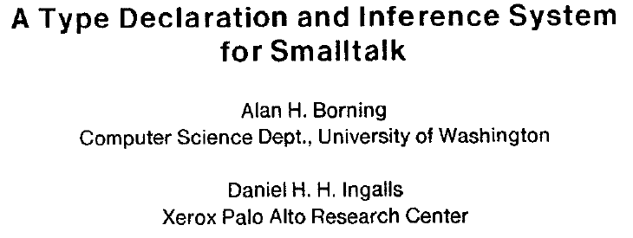
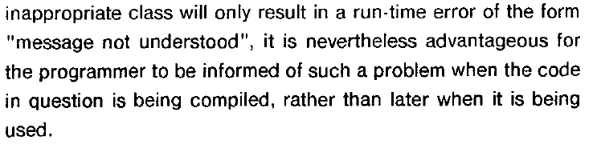
POPL 1982

Slide 38
Retrofitted Type System Design Principle
Statically prevent (most)
existing run-time errors

Slide 39
“a string” – “another string”
→ NaN
Arithmetic doesn’t signal errors
No arity mismatch errors
Reading non-existent field → undefined
Writing non-existent field → creates field
Unbound identifiers → same story
Breaching array bounds → undefined
Object weirdness, too

Slide 40
Handles var-arity functions
Arithmetic doesn’t signal errors
No arity mismatch errors
Reading non-existent field → undefined
Writing non-existent field → creates field
Unbound identifiers → same story
Handles prototype extension

Slide 41
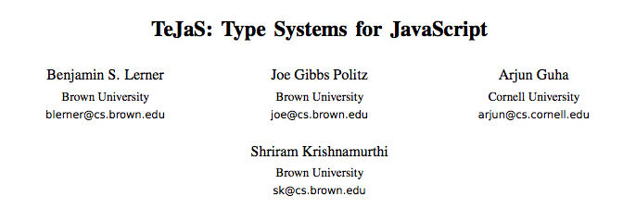
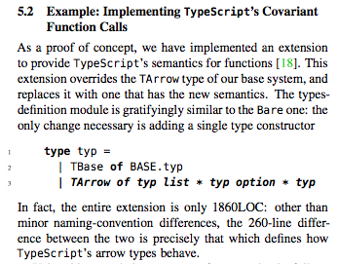

Slide 42
p : {x: Num, y: Num} ∪ Num
function fromOrigin(p) {
if (typeof p === “object”) {
return Math.sqrt(p.x * p.x + p.y * p.y);
} else {
return Math.abs(p);
}
}
p : {x: Num, y: Num}
p : Num

Slide 43
function serialize(val) {
switch (typeof val) {
case "undefined":
case "function":
return false;
case "boolean":
return val ? "true" :
"false";
case "number":
return "" + val;
case "string":
return val;
}
Any -> String ∪ Bool
if (val === null)
{ return "null"; }
var fields = [ ];
for (var p in val) {
var v = serialize(val[p]);
if (typeof v === "string") {
fields.push(p + ": " + v);
}
}
return "{ " +
fields.join(", ") +
" }";
}
where is case "object"?

Slide 44
function serialize(val) {
switch (typeof val) {
case "undefined":
case "function":
return false;
case "boolean":
return val ? "true" :
"false";
case "number":
return "" + val;
case "string":
return val;
}
Any -> String ∪ Bool
if (val === null)
{ return "null"; }
var fields = [ ];
for (var p in val) {
var v = serialize(val[p]);
if (typeof v === "string") {
fields.push(p + ": " + v);
}
}
return "{ " +
fields.join(", ") +
" }";
}
implicit case "object"

Slide 45
Control Operators
if, ?:
while, for, do, for in
switch, continue, break, label:
&&, ||, throw, try catch finally

Slide 46
var slice = function (arr, start, stop) {
var result = [];
for (var i = 0; i <= stop - start; i++) {
result[i] = arr[start + i];
}
return result;
}
slice([5, 7, 11, 13], 0, 2)
[5, 7, 11]
slice([5, 7, 11, 13], 2)
arity mismatch error?

Slide 47
stop: Num ∪ Undef
var slice = function (arr, start, stop) {
if (typeof stop === "undefined") {
stop = arr.length – 1;
}
var result = [];
for (var i = 0; i <= stop - start; i++) {
result[i] = arr[start + i];
}
return result;
}
slice([5, 7, 11, 13], 0, 2)
[5, 7, 11]
slice([5, 7, 11, 13], 2)
→ [11, 13]
stop: Undef
stop: Num
stop: Num

Slide 48
Checks For | JS Gadgets | ADsafe | Python stdlib | Ruby stdlib | Django | Rails
LOC | 617,766 | 2,000 | 313,938 | 190,002 | 91,999 | 294,807
undefined/null | 3,298 | 0 | 1,686 | 538 | 868 | 712
instanceof | 17 | 45 | 613 | 1,730 | 647 | 764
typeof | 474 | 40 | 381 | N/A | 4 | N/A
field-presence | unknown | unknown | 504 | 171 | 348 | 719
Total Checks | 3,789 | 95 | 3,184 | 2,439 | 1,867 | 2,195

Slide 49
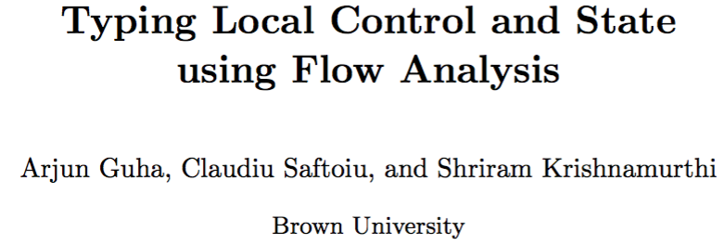
Moral
Scripting language programmers use state and non-trivial control flow to refine types

Slide 50
Our Recipe
Simple type checker (not quite enough)
Add tag-based casts (breaks progress)
Simple flow analysis (w/ preservation broken)
“Types on the outside, flows on the inside”
The composition is sound
The performance is great (seconds on netbook)

Slide 51
Semantics
Type Systems
Security and Other Uses
Issues with Desugaring
Future Directions

Slide 52
Security and Other Uses
Putting Types to Work

Slide 53
✗Expected function, got string
"not-a-func"(3)
null["x"]
✗Expected object, got null

Slide 54
Typed JavaScript
Web Sandbox Verification
✗
OK!
"not-a-func"(3)
null["x"]
"not-a-func"(3)
null["x"]
✗
OK!
Normal type-safety properties are non-properties for the sandbox

Slide 55
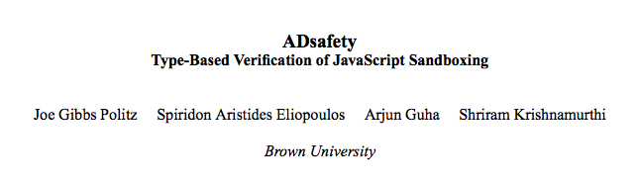
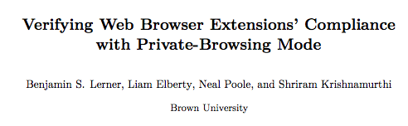
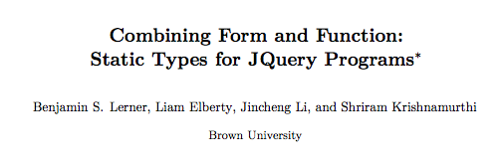

Slide 56
Sandbox
JavaScript Type
Checker
FAIL!
Allow Certain Errors
Re-Engineer?
Impractical
Typable Sandbox
Sandbox
Type Checker
Unwanted

Slide 57
JavaScript
Type Checker
jQuery
Type Checker
Sandbox
Type Checker
Extension
Type Checker
We want to control which guarantees we want from the type system.
And those we don’t.
Bring the types to the code, not vice versa.

Slide 58
Purpose
Errors

Slide 59
Purpose
Theorem
Errors

Slide 60
?
untyped
typed
What does the guarantee mean?
gradual typing
Where does the guarantee apply?

Slide 61
Type Soundness
Preservation
If Γ ⊢ e : τ and e → e’, then
Γ ⊢ e’ : τ
If Γ ⊢ e : τ, then either
e is a value
∃ e’ . e → e’
e is one of a pre-defined set of errors
Progress

Slide 62
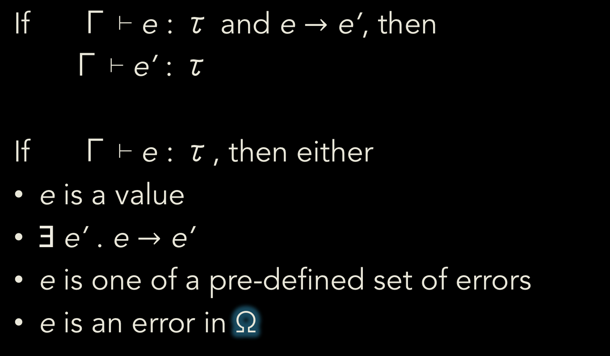
Type Soundness
Preservation
If Γ ⊢ e : τ and e $→$ e’, then
Γ ⊢ e’ : τ
If Γ ⊢ e : τ, then either
e is a value
∃ e’ . e $→$ e’
e is one of a pre-defined set of errors
e is an error in Ω
Ω;
Ω;
Ω;
Progress

Slide 63

typed
What does the guarantee mean?
untyped
gradual typing
Where does the guarantee apply?

Slide 64
Semantics
Type Systems
Security and Other Uses
Issues with Desugaring
Future Directions

Slide 65
Issues with Desugaring

Slide 66
L program
desugar
λ_{L} program
L evaluator
λ_{L} evaluator
“their answer”
“our answer”

Slide 67
var o = new Object()
o.x = 1
{let
(%context = %nonstrictContext)
{%defineGlobalVar(%context,
"o");
%defineGlobalAccessors(%context,
"Object");
{let
(#strict = false)
{%EnvCheckAssign(%context,
"o",
{let
(%constr1 = %context["Object" , {[#proto: null,
#class: "Object",
#extensible: true,]}])
if (prim("!", prim("stx=", prim("typeof", %constr1) , "function")))
{%TypeError("Constructor was not a function")}
else
{{let
(%cproto2 = %constr1["prototype" , {[#proto: null,
#class: "Object",
#extensible: true,]}])
try
{%set-property(%ToObject(%context["o" , {[#proto: null,
#class: "Object",
#extensible: true,]}]),
"x",
1.)}
catch
{%ErrorDispatch}}}}}
{let
(%cproto2 = if (%IsObject(%cproto2))
{%cproto2}
else
{%ObjectProto})
{if (prim("!", %IsObject(%cproto2)))
{%cproto2 := %ObjectProto}
else
{undefined};
{let
(%newobj3 = {[#proto: %cproto2,
#class: "Object",
#extensible: true,]})
if (prim("stx=", %constr1[<#code>] , null))
{%TypeError("Constructor was not applicable")}
else
{{let
(%constr_ret4 = %constr1(%newobj3,
%mkNewArgsObj
({[#proto: null,
#class: "Object",
#extensible: true,]})))
if (%IsObject(%constr_ret4))
{%constr_ret4}
else
{%newobj3}}}}}}}}},
#strict);

Slide 68
function iden(a){return a}
iden(1)
{let
(%context = %nonstrictContext)
{%defineGlobalVar(%context,
"iden");
{let
(#strict = false)
{{let
(%fobj7 = {let
(%prototype5 = {[#proto: %ObjectProto,
#class: "Object",
#extensible: true,]
'constructor' : {#value (undefined) ,
#writable true ,
#configurable false}})
{let
(%parent = %context)
{let
(%thisfunc6 = {[#proto: %FunctionProto,
#code: func(%this , %args)
{%args[delete "%new"];
label %ret :
{{let
(%this = %resolveThis(#strict,
%this))
{let
(%context = {let
(%a4 = %args
["0" , null])
{[#proto: %parent,
#class: "Object",
#extensible: true,]
'arguments' : {#value (%args) ,
#writable true ,
#configurable false},
'a' : {#getter func
(this , args)
{label %ret :
{break %ret %a4}} ,
#setter func
(this , args)
{label %ret :
{break %ret %a4 := args
["0" , {[#proto: %ArrayProto,
#class: "Array",
#extensible: true,]}]}}}}})
{break %ret %context["a" , {[#proto: null,
#class: "Object",
#extensible: true,]}];
undefined}}}}},
{let
(%fun2 = %context["iden" , {[#proto: null,
#class: "Object",
#extensible: true,]}])
{let
(%ftype3 = prim("typeof", %fun2))
if (prim("!", prim("stx=", %ftype3 , "function")))
{%TypeError("Not a function")}
else
{%fun2(undefined,
%mkArgsObj({[#proto: null,
#class: "Object",
#extensible: true,]
'0' : {#value (1.) ,
#writable true ,
#configurable true}}))}}}}}}}
#class: "Function",
#extensible: true,]
'prototype' : {#value (%prototype5) ,
#writable true ,
#configurable true},
'length' : {#value (1.) ,
#writable true ,
#configurable true},
'caller' : {#getter %ThrowTypeError ,
#setter %ThrowTypeError},
'arguments' : {#getter %ThrowTypeError ,
#setter %ThrowTypeError}})
{%prototype5["constructor" = %thisfunc6 , null];
%thisfunc6}}}})
%context["iden" = %fobj7 ,
{[#proto: null, #class: "Object", #extensible: true,]
'0' : {#value (%fobj7) , #writable true , #configurable true}}]};

Slide 69
Why is the Output So Big?
Why is This a Problem?
Intended complexity: small core
Incidental complexity: codegen
Essential complexity: semantics

Slide 70
Semantics-Preserving Rewrites: 10-30% Shrinkage
Dead-code elimination
Constant folding
Constant propagation
Alias propagation
Infer types + eliminate static checks
Unwrap object properties as identifiers
Turn mutation into let-bindings
Clean unused environment bindings
Generic compiler transformations
λ_{JS}-specific transformations

Slide 71
Semantics-Altering Rewrites:

Slide 72
Semantics-altering?!?
All “static” tools handle sub-languages

Slide 73
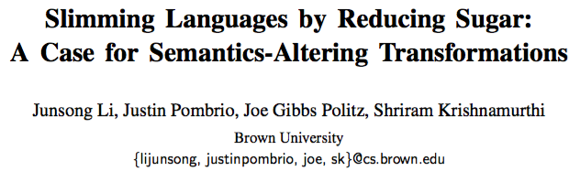
Semantics-Altering
Disable variable-arity functions
Eliminate static safety checks
Gives anywhere from 1-30% reduction
Many more opportunities:
function is not used as constructor
No assignm’t to globals (window, top-level this)
Arithmetic ops applied only to strings or numbers

Slide 74
var o = new Object()
o.x = 1
{let
(o = {let
(%cproto2 = %ObjectGlobalFuncObj["prototype" , {[#proto: null,
#class: "Object",
#extensible: true,]}])
{let
(%newobj3 = {[#proto: %cproto2, #class: "Object", #extensible: true,]})
{let
(%constr_ret4 = %ObjectGlobalFuncObj(%newobj3,
%mkNewArgsObj({[#proto: null,
#class: "Object",
#extensible: true,]})))
if (%IsObject(%constr_ret4))
{%constr_ret4}
else
{%newobj3}}}})
try
{%set-property(%ToObject(o),
"x",
1.)}
catch
{%ErrorDispatch}}
-opt-less-mutation -opt-alias-propagation
-opt-type-infer -opt-const-propagation
-opt-const-folding -opt-no-checks
-opt-deadcode-elimination

Slide 75
function iden(a){return a}
iden(1)
{let
(iden = func(%this , %a4)
{%a4}})
iden(undefined,
1.)}
-opt-preprocess -opt-less-mutation -opt-alias-propagation
-opt-type-infer -opt-fixed-arity -opt-unwrap-lambda -opt-const-propagation
-opt-deadcode-elimination -opt-const-folding

Slide 76
Semantics
Type Systems
Security and Other Uses
Issues with Desugaring
Future Directions

Slide 77
Future Work
Type Systems

Slide 78
Dependent Types
Scripts have extremely dependent types
Illustrative examples:
jQuery shapes
First-class name-based member access
R arrays, vectors: one-dimensional indexing with +num, -num, booleans

Slide 79
Duck Typing
If it looks like structural typing, swims like structural typing, and quacks like structural typing …

Slide 80
Future Work
Toward clearer sub-languages

Slide 81
Sub-Languages
Formalize the sub-languages of papers
These command-line flags are a specification of a paper’s sub-language:
-opt-fixed-arity
-opt-unwrap-lambda
-opt-no-checks

Slide 82
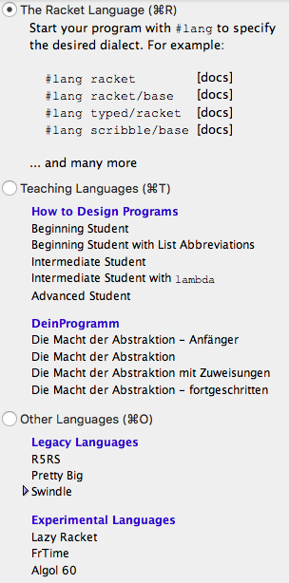
Look for Inspiration

Slide 83
Future Work
Resugaring

Slide 84
Surface T
desugar
Core T₁
How to present as a surface evaluation sequence?
Core T₂
Black-box
transition
system
resugar
Core T₃
Core T₄

Slide 85
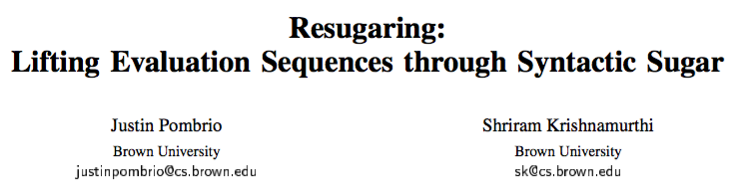
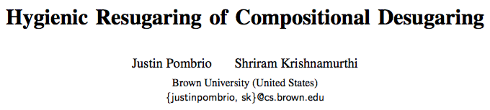
desugar
L
λ_{L}
Three key properties:
Emulation Desugaring a re-sugared term yields the same desugared term
Abstraction Re-sugaring does not show terms introduced by desugaring
Completeness Doesn’t skip expected steps
L
λ_{L}
λ_{L}
λ_{L}
L
λ_{L}

Slide 86
Everything Can (and Should) be Resugared
Evaluation sequences
Scope rules
Types
Error messages…

Slide 87
Future Work
The Next 700 Semantics

Slide 88
Tested Semantics Effort
Artifact | Effort | People
Cisco IOS | 1y x 2 | 1 PhD, 1 MS
EcmaScript 3 | 3m × 2 | 1 PhD, 1 UG
EcmaScript 5 Safe | 5m × 4 | 1 PD, 2 PhD, 1 MS
DOM Events | 7m × 4 | 1 PD, 1 PhD, 1 MS, 1 UG
Python | 9m x 8 | 1 PhD, 3 UG, 3 Other
Scattered worldwide — recruited from a MOOC

Slide 89
L program
desugar
λ_{L} program
Learn this using machine translation techniques

Slide 90
Important Differences
MT Tree Alignment needs:
Lots of sentences of input (easy)
Lots of sentences of output (easy)
Lots of examples of translations (oops!) Typically at least 1mil, preferably 10mil
But MT also lacks something we have…

Slide 91
L program
desugar
λ_{L} program
L evaluator
λ_{L} evaluator
“their answer”
“our answer”
These represent ground truth

Slide 92
Current Status
We’ve tried four different approaches:
Naïve tree matching
Tree transduction by Gibbs sampling
Genetic programming
Sketching
None has yet succeeded beyond toy examples

Slide 93
The Next 700 Semantics
(of which we have ~3)

Slide 94
Coda

Slide 95
The Modelers’ Hippocratic Oath Emmanuel Derman and Paul Wilmott
I will remember that I didn't make the world, and it doesn't satisfy my equations.
Though I will use models boldly to estimate value, I will not be overly impressed by mathematics.
I will never sacrifice reality for elegance without explaining why I have done so.
Nor will I give the people who use my model false comfort about its accuracy. Instead, I will make explicit its assumptions and oversights.
I understand that my work may have enormous effects on society and the economy, many of them beyond my comprehension.
http://www.wilmott.com/blogs/eman/index.cfm/2009/1/8/The-Financial-Modelers-Manifesto

